Slide 1
Computer Vision
Lecture-2 (10th Aug 2022)

Slide 2
Till now

Slide 3
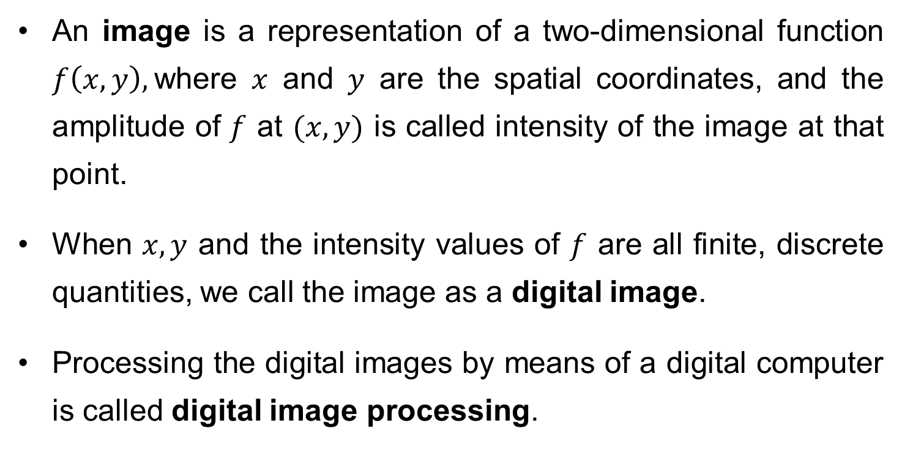
What is a Digital Image?
An image is a representation of a two-dimensional function $f\left(x,y\right),$where $x$ and $y$ are the spatial coordinates, and the amplitude of $f$ at $(x,y)$ is called intensity of the image at that point.
When $x, y$ and the intensity values of $f$ are all finite, discrete quantities, we call the image as a digital image.
Processing the digital images by means of a digital computer is called digital image processing.

Slide 4

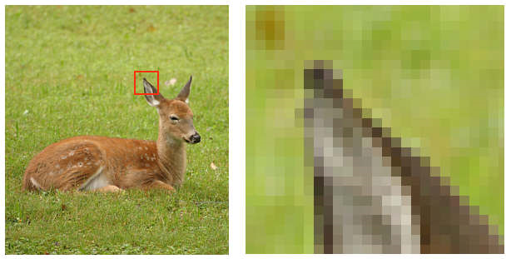
cont…
A digital image is composed of finite number of elements, each having location and value. These elements are called pixels/picture elements.
1 pixel

Slide 5
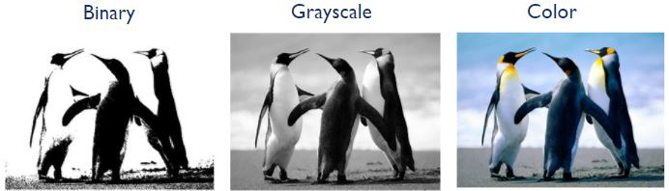
cont…
Common image formats include:
1 sample per point (B&W/binary, Grayscale)
3 samples per point (Red, Green, and Blue)

Slide 6
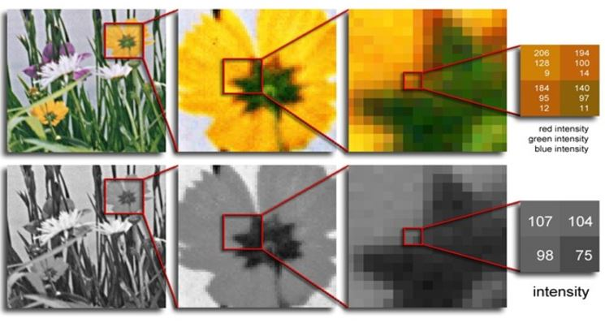
cont…

Slide 7
Key Stages in an Image Processing
Image Restoration
Morphological Processing
Image Enhancement
Segmentation
Image Acquisition
Representation & Description
Object Recognition
Problem Domain
Colour Image Processing
Image Compression

Slide 8

Image Acquisition
Image Restoration
Morphological Processing
Image Enhancement
Segmentation
Image Acquisition
Representation & Description
Object Recognition
Problem Domain
Colour Image Processing
Image Compression

Slide 9
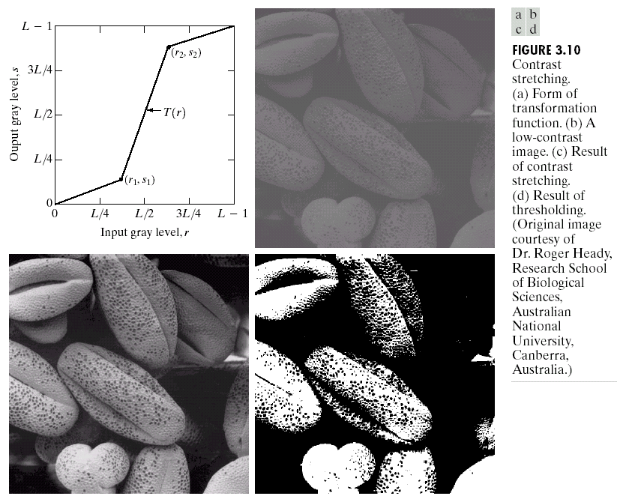
Image Enhancement
Image Restoration
Morphological Processing
Image Enhancement
Segmentation
Image Acquisition
Representation & Description
Object Recognition
Problem Domain
Colour Image Processing
Image Compression

Slide 10
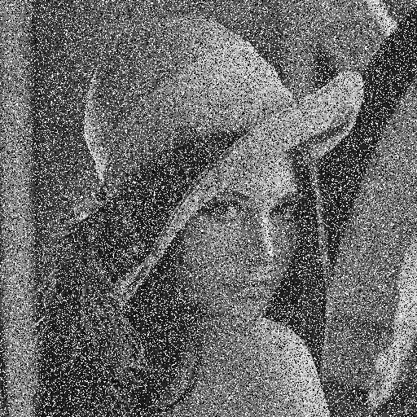
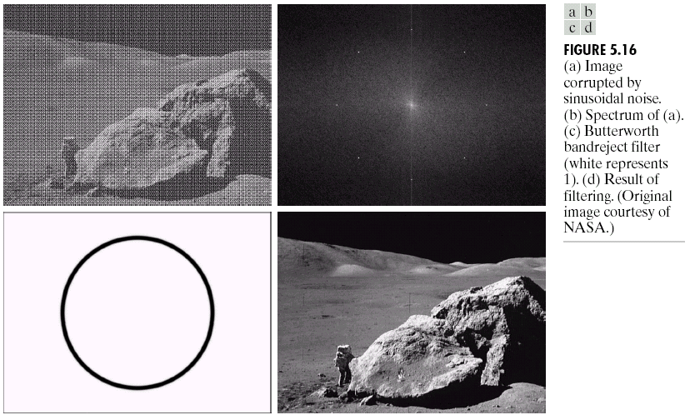
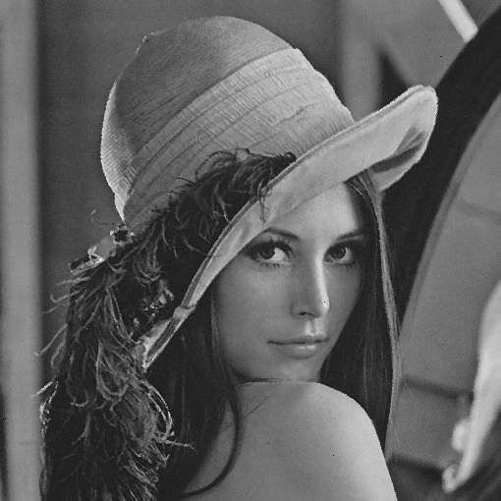
Image Restoration
Image Restoration
Morphological Processing
Image Enhancement
Segmentation
Image Acquisition
Representation & Description
Object Recognition
Problem Domain
Colour Image Processing
Image Compression

Slide 11


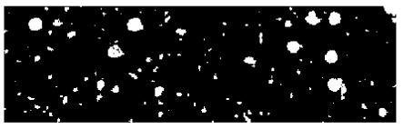
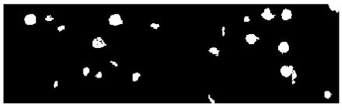
Morphological Processing
Image Restoration
Morphological Processing
Image Enhancement
Segmentation
Image Acquisition
Representation & Description
Object Recognition
Problem Domain
Colour Image Processing
Image Compression

Slide 12
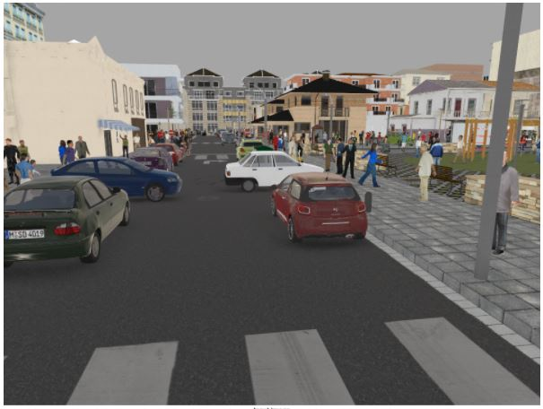
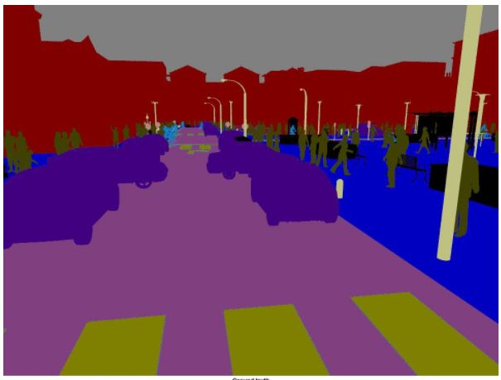
Segmentation
Image Restoration
Morphological Processing
Image Enhancement
Segmentation
Image Acquisition
Representation & Description
Object Recognition
Problem Domain
Colour Image Processing
Image Compression

Slide 13
Representation & Description
Image Restoration
Morphological Processing
Image Enhancement
Segmentation
Image Acquisition
Representation & Description
Object Recognition
Problem Domain
Colour Image Processing
Image Compression

Slide 14
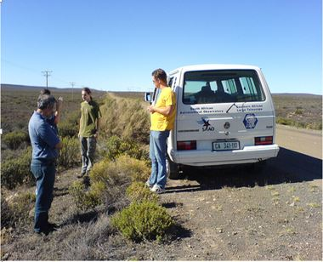
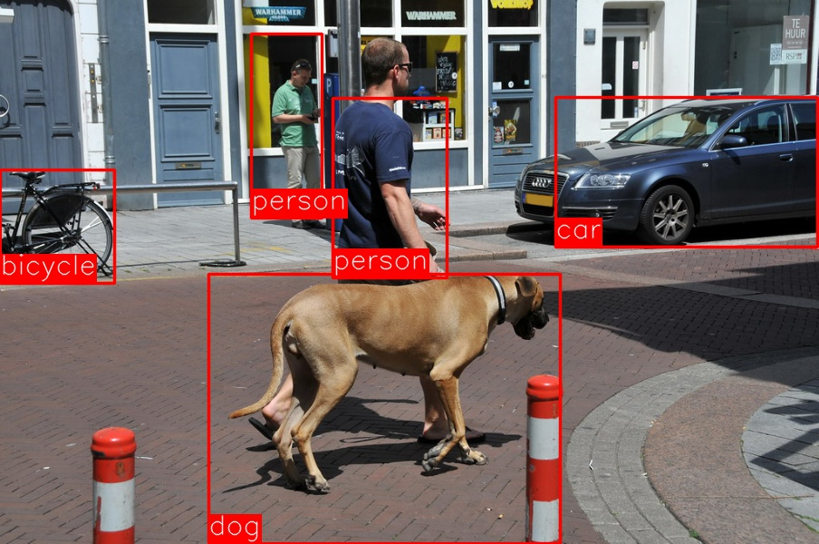
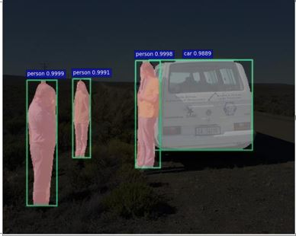
Object Recognition
Image Restoration
Morphological Processing
Image Enhancement
Segmentation
Image Acquisition
Representation & Description
Object Recognition
Problem Domain
Colour Image Processing
Image Compression

Slide 15
Image Acquisition Process
View at lens focal plane

Slide 16
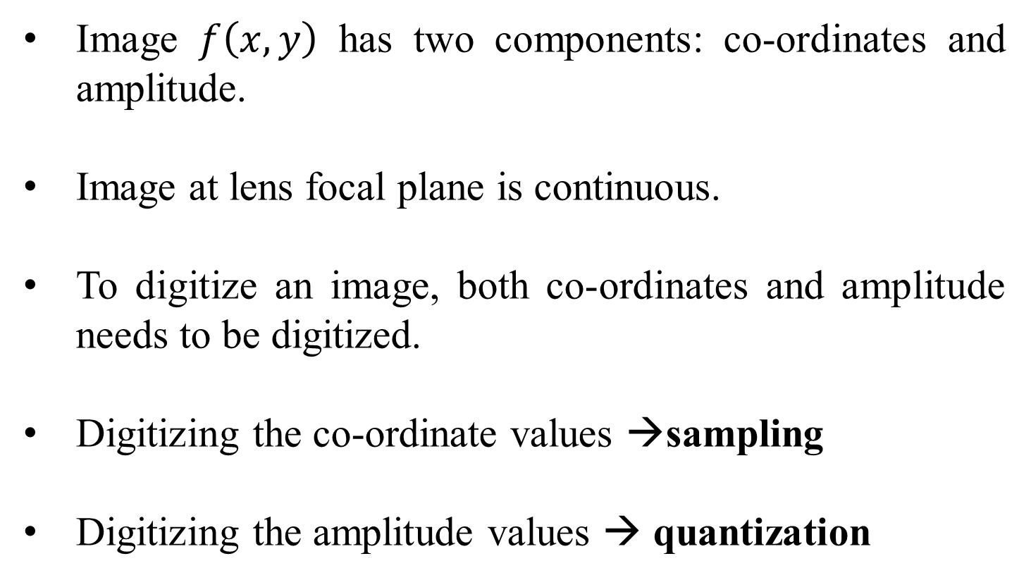
Image Sampling and Quantization
Image $f\left(x,y\right)$ has two components: co-ordinates and amplitude.
Image at lens focal plane is continuous.
To digitize an image, both co-ordinates and amplitude needs to be digitized.
Digitizing the co-ordinate values →sampling
Digitizing the amplitude values → quantization

Slide 17
How many quantization levels can we have?
Quantization levels→ [0, L-1]
L=2^{k}
k →no. of bits per channel

Slide 18
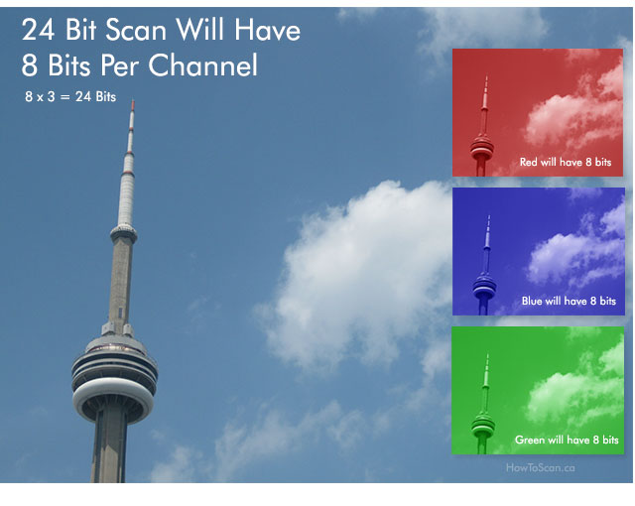
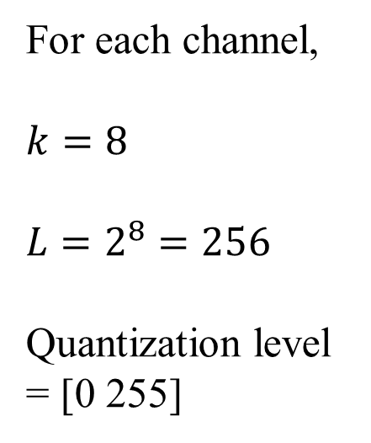
Example
For each channel,
$$k=8$$
$$L=2^{8}=256$$
Quantization level = [0 255]

Slide 19
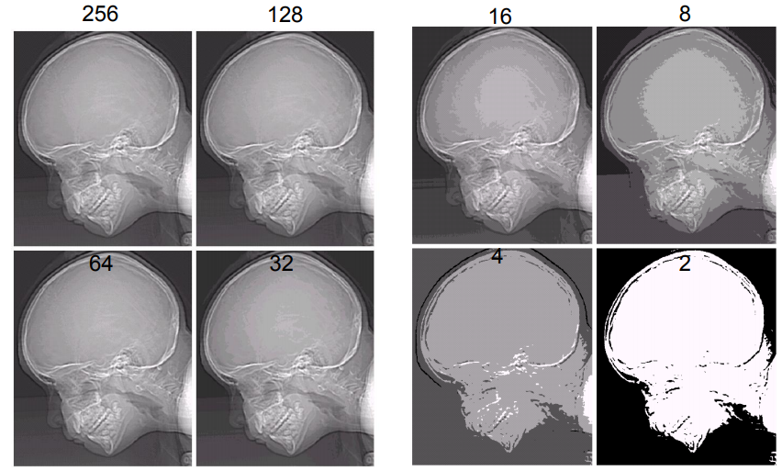
Images with varying intensity levels ‘L’

Slide 20
The number ‘b’ of bits required to store a M × N digitized image
b = M × N × k
k representing k bit image

Slide 21
Basic relationships between pixels
Neighborhood
Connectivity
Adjacency
Paths
Regions and boundaries

Slide 22
Neighborhood
Neighbors of a pixel p at coordinates (x,y)
4-neighbors of p, denoted by N₄(p):
(x-1, y), (x+1, y), (x,y-1), and (x, y+1).
4 diagonal neighbors of p, denoted by N_{D}(p):
(x-1, y-1), (x+1, y+1), (x+1,y-1), and (x-1, y+1).
8 neighbors of p, denoted N₈(p)
N₈(p) = N₄(p) U N_{D}(p)

Slide 23
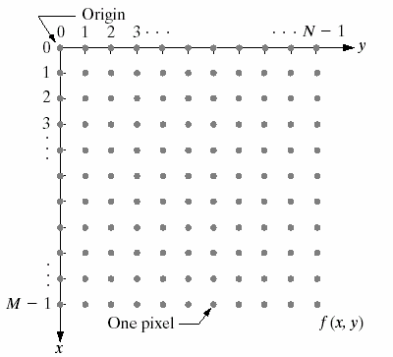
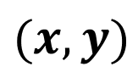
$$(x,y)$$

Slide 24
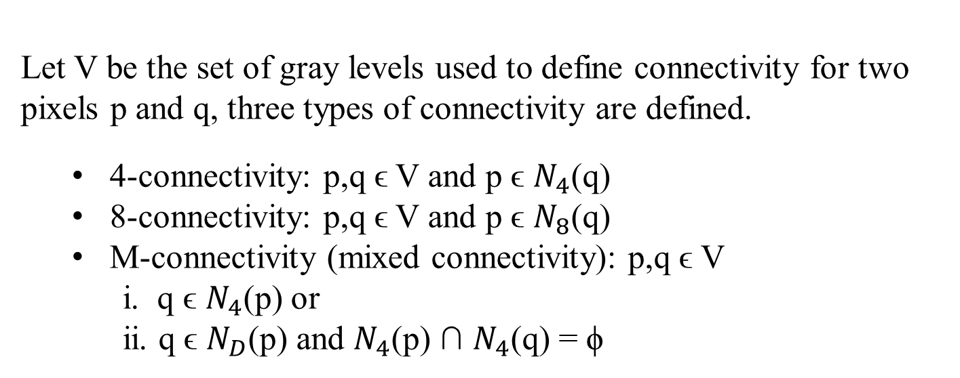
Connectivity
Let V be the set of gray levels used to define connectivity for two pixels p and q, three types of connectivity are defined.
4-connectivity: p,q ϵ V and p ϵ $N_{4}$(q)
8-connectivity: p,q ϵ V and p ϵ $N_{8}$(q)
M-connectivity (mixed connectivity): p,q ϵ V
i. q ϵ $N_{4}$(p) or
ii. q ϵ $N_{D}$(p) and $N_{4}$(p) ∩ $N_{4}$(q) = ϕ
Eg. V={1}
0 | 1 | 1
0 | 1 | 0
0 | 0 | 1
0 | 1 | 1
0 | 1 | 0
0 | 0 | 1
0 | 1 | 1
0 | 1 | 0
0 | 0 | 1
q
p
4-connectivity
8-connectivity
M-connectivity

Slide 25
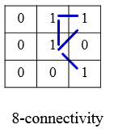
Path
A (digital) path (or curve) from pixel p with coordinates (x₀, y₀) to pixel q with coordinates (x_{n}, y_{n}) is a sequence of distinct pixels with coordinates
(x₀, y₀), (x₁, y₁), …, (x_{n}, y_{n})
where (x_{i}, y_{i}) and (x_{i-1}, y_{i-1}) are adjacent for 1 ≤ i ≤ n.
Here n is the length of the path.
If (x₀, y₀) = (x_{n}, y_{n}), the path is closed path.
We can define 4-, 8-, and m-paths based on the type of adjacency used.
p
q

Slide 26
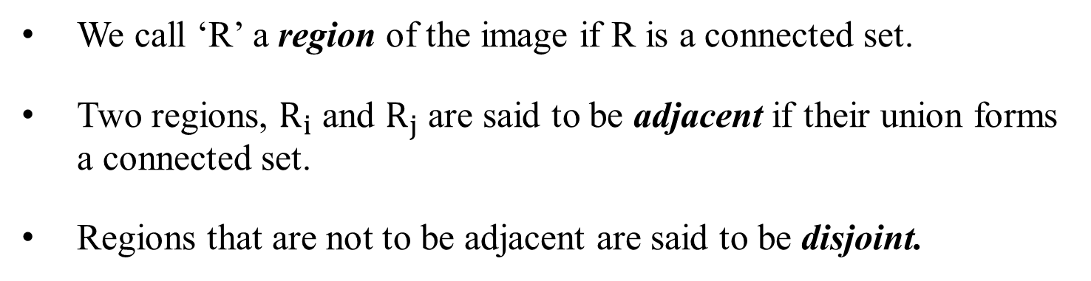
Region & Adjacency
We call ‘R’ a region of the image if R is a connected set.
Two regions, $R_{i}$ and $R_{j}$ are said to be adjacent if their union forms a connected set.
Regions that are not to be adjacent are said to be disjoint.
1 | 1 | 1
1 | 0 | 1
0 | 1 | 0
0 | 0 | 1
1 | 1 | 1
1 | 1 | 1
Region 1
8-adjacency
4-adjacency
8-adjacency
m-adjacency
Region 2

Slide 27
Boundary
The boundary of the region R is the set of pixels in the region that have one or more neighbors that are not in R (background).
0 | 1 | 0 | 0 | 0
1 | 1 | 1 | 0 | 0
0 | 1 | 1 | 1 | 0
0 | 1 | 1 | 1 | 1
1 | 1 | 1 | 1 | 0
0 | 1 | 0 | 0 | 0
Black- background
White- foreground
8 - connectivity

Slide 28
0 | 1 | 0 | 0 | 0
1 | 1 | 1 | 0 | 0
0 | 1 | 1 | 1 | 0
0 | 1 | 1 | 1 | 1
1 | 1 | 1 | 1 | 0
0 | 1 | 0 | 0 | 0
Black- background
White- foreground
8 - connectivity
4 - connectivity
MATLAB: B = bwboundaries (binary_image,connectivity)

Slide 29
Topics to be covered today:
Distance measures
Image enhancement techniques
Intensity transformation function
Image negative
Log transformation
Gamma transformation
Piecewise linear transformation
Contrast stretching
Intensity level slicing
Histogram processing

Slide 30
Distance Measures
Given pixels p, q and z with coordinates (x, y), (s, t), (u, v) respectively, the distance function D has following properties:
D(p, q) ≥ 0 [D(p, q) = 0, iff p = q]
D(p, q) = D(q, p)
D(p, z) ≤ D(p, q) + D(q, z)

Slide 31
Euclidean Distance
The Euclidean Distance between p and q is defined as:
D_{e} (p,q) = [(x – s)² + (y - t)²]^{1/2}
D_{e} (p,q)
q (s,t)
p (x,y)

Slide 32
City-Block Distance
The D₄ distance (also called city-block distance) between p and q is defined as:
D₄ (p,q) = | x – s | + | y – t |
q (s,t)
D₄
p (x,y)

Slide 33
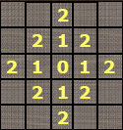

Pixels having a D₄ distance from (x,y), less than or equal to some value r form a Diamond centered at (x,y).
say $r≤2$
(x,y)

Slide 34
Chessboard Distance
The D₈ distance (also called chessboard distance) between p and q is defined as:
D₈ (p,q) = max(| x – s |,| y – t |)
q (s,t)
D_{8(b)}
p (x,y)
D_{8(a)}
D₈ = max(D_{8(a) ,} D_{8(b)})

Slide 35
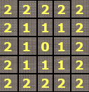
Pixels having a D₈ distance from (x,y), less than or equal to some value r form a square centered at (x,y).
say $r≤2$
(x,y)

Slide 36
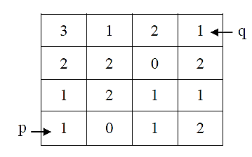
Q.
Let V={0, 1}. Compute the lengths of the shortest 4-path, 8-path and m-path between ‘p’ and ‘q’ shown in figure below. Also show the path formed. What is the value of Chessboard distance and City block distance

Slide 37
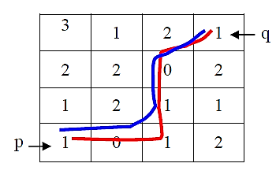
Ans:
When V={0, 1}, 4-path does not exist.
The shortest 8-path has length = 4 (as shown in blue line) and the shortest m-path has length = 5 (as shown in red line).
Chessboard distance : 3
City block distance : 6

Slide 38
Image enhancement techniques
Objective – process an image so that the result is more suitable than the original image for a specific application. (improve the quality)
Methods:
Spatial Domain direct manipulation of pixels of the image
Frequency Domain modifying the frequency transformed image

Slide 39
Spatial Domain
These techniques operate directly on the pixels.
More efficient computation and requires less processing resources to implement
Spatial Domain Process is defined by g(x,y)=T[f(x,y)]
T is an operator on input image defined over a neighborhood of point (x,y)
OUTPUT IMAGE
INPUT IMAGE

Slide 40
1. Image Negative
Let the image has an intensity level in the range [0 L-1], then the intensity transformation is given by s=L-1-r
s=T(r)
L-1
L=intensity levels
Output intensity
0
L-1
r
Input intensity

Slide 41
2. Log Transformation
For an image having intensity ranging from [0 L-1], log transformation is given by s=c log(1+r) , where c is a constant.
s=T(r)
Maps the narrow range of low intensity values of input levels to wider range of output levels.
Higher range of high intensity input levels is mapped to narrow range of output levels.
L-1
Output intensity
0
L-1
r
Input intensity

Slide 42
3. Power-law (Gamma) Transformation
This has the basic form s=c r^{γ} ,where c and γ are positive constants
Dark input → bright output when gamma<1
Same input and output at gamma=1
bright input → dark output when gamma >1
Plot for c=1

Slide 43
Gamma correction is very important when to reproduce an image exactly on a display system.
MRI of fractured human spine
Result of a transformation for γ=0.3

Slide 44
MRI of fractured human spine
Result of a transformation for γ=0.6
Result of a transformation for γ=0.4
Result of a transformation for γ=0.3

Slide 45
Result of a transformation for c=1 and γ=3
Arial image

Slide 46
Result of a transformation for c=1 and γ=4
Result of a transformation for c=1 and γ=5

Slide 47
4. Contrast stretching
s = T(r)
L-1
Sometimes, image viewed in the screen is very dark (poor contrast).
Poor illumination
dynamic range of the sensor is very small. (capacity to record min and max intensity value)
aperture of lens is not properly set.
light
output intensity level, s
dark
0
0
L-1
dark
light
Expand a range of intensities at input to desired range at output.
Input intensity level, r

Slide 48
Contrast stretching
L-1
Controls the shape of the transformation function
(r₂,s₂)
3L/4
L/2
T(r)
output intensity level, s
L/4
0
(r₁,s₁)
0
L/4
L/2
3L/4
L-1
Input intensity level, r

Slide 49
Contrast stretching
Suppose r₁=s₁ and r₂=s₂
L-1
L-1
(r₂,s₂)
(r₂,= s₂)
3L/4
3L/4
L/2
T(r)
L/2
T(r)
output intensity level, s
output intensity level, s
L/4
L/4
(r₁,s₁)
(r₁,=s₁)
0
0
0
L/4
L/2
3L/4
L-1
0
L/4
L/2
3L/4
L-1
Input intensity level, r
Input intensity level, r

Slide 50
Contrast stretching
Suppose r₁=r₂ and s₁=0 and s₂=L-1
L-1
(r₂)
L-1
(r₂,s₂)
3L/4
3L/4
L/2
T(r)
L/2
T(r)
output intensity level, s
output intensity level, s
L/4
L/4
(r₁,s₁)
0
0
(r₁)
0
L/4
L/2
3L/4
L-1
0
L/4
L/2
3L/4
L-1
Input intensity level, r
Input intensity level, r

Slide 51
Contrast stretching (Example)

Slide 53
Contrast stretching (Example)

Slide 54
5. Intensity Level slicing
Highlighting specific range of intensities.
Example :
Enhancing features such as masses of water in the satellite imagery
Enhancing flaws in X-ray images.
Contrast stretching: whole image intensity is affected

Slide 55
L-1
L-1
T(r)
s
r
0
L-1

Slide 56
L-1
T(r)
s
r
0
L-1

Slide 57
Intensity Level slicing (Example)

Slide 58
6. Histogram Processing
What is histogram
Histogram based techniques
Histogram equalization
Histogram specification/matching/modification

Slide 59

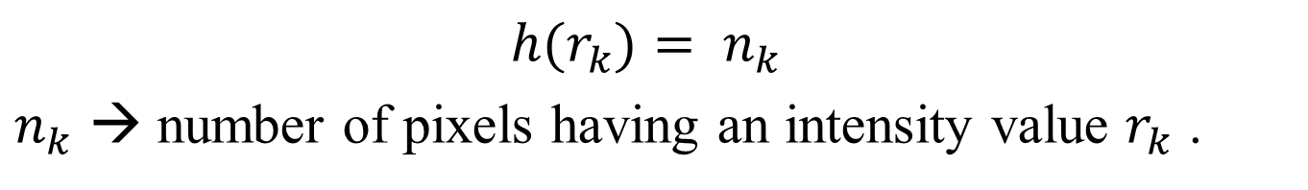
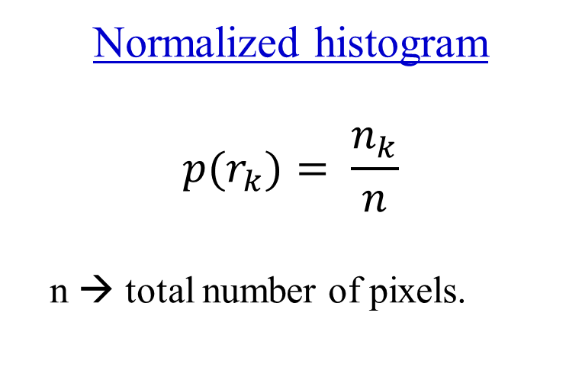
What is a histogram?
→Gives a global description of an appearance of an image.
${h(r}_{k})= n_{k}$
$n_{k}$ → number of pixels having an intensity value $r_{k}$ .
$$n_{k}$$
Normalized histogram
$${p(r}_{k})= \frac{n_{k}}{n}$$
n → total number of pixels.
Intensity values

Slide 60
Dark image
Darker region

Slide 61
Bright image
Lighter region

Slide 62
Low contrast image
Neither dark nor bright

Slide 63
High contrast image
Detailed image

Slide 64
Histogram gives global appearance not the content of image.
Histogram based techniques modifies the histogram of image to appear in the way we want.
Histogram equalization
Histogram specification/matching/modification

Slide 65
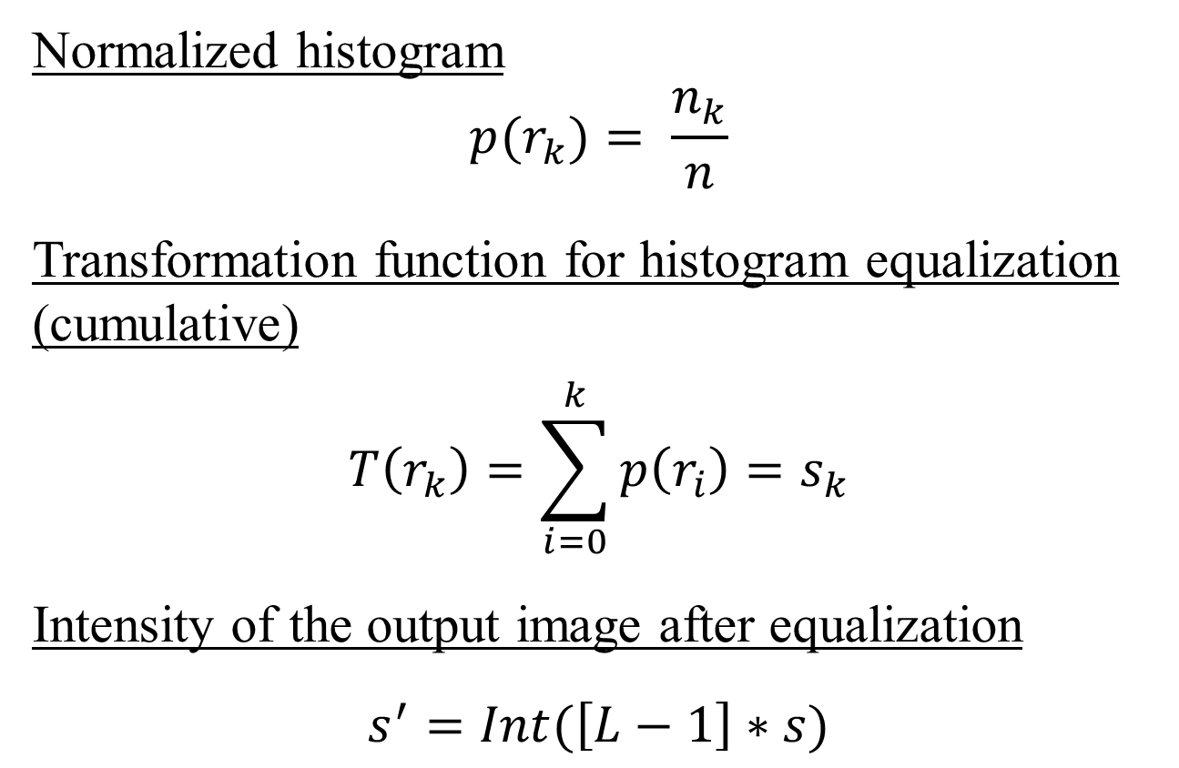
Histogram equalization
Normalized histogram
$${p(r}_{k})= \frac{n_{k}}{n}$$
Transformation function for histogram equalization
(cumulative)
$$T\left(r_{k}\right)=\sum_{i=0}^{k}{p\left(r_{i}\right)}=s_{k}$$
Intensity of the output image after equalization
$$s^{′}=Int(\left[L−1\right]∗s)$$

Slide 66
R (input intensity values) | No. of pixels | P(r) (normalized histogram) | T(r) CDF | s’ (output intensity values)
0 | 2 | 0.05 | 0.05 | 0
1 | 2 | 0.05 | 0.1 | 0
2 | 0 | 0 | 0.1 | 0
3 | 0 | 0 | 0.1 | 0
4 | 0 | 0 | 0.1 | 0
5 | 6 | 0.15 | 0.25 | 1
6 | 14 | 0.35 | 0.60 | 4
7 | 16 | 0.40 | 1 | 7
 | Sum=40

Slide 67
R (input intensity values) | No. of pixels | P(r) (normalized histogram) | T(r) CDF | s’ (output intensity values)
0 | 2 | 0.05 | 0.05 | 0
1 | 2 | 0.05 | 0.1 | 0
2 | 0 | 0 | 0.1 | 0
3 | 0 | 0 | 0.1 | 0
4 | 0 | 0 | 0.1 | 0
5 | 6 | 0.15 | 0.25 | 1
6 | 14 | 0.35 | 0.60 | 4
7 | 16 | 0.40 | 1 | 7
 | Sum=40

